Slide 1
Case Study On Netflix
Presented by : Vijayalakshmi
Last Updated : November 20th,2023

Slide 2
Table of Contents
Objective of the Analysis
Insights of the Data
Conclusion

Slide 3
Objective
Identify the elements that could boost Netflix's streaming service, attracting a larger global user base
and subscribers, ultimately leading to improved profitability for the company in the future.
Key Elements are :
1
2
3
Movies Released Time/Year
Languages of the Movies
Genres of the Movies

Slide 4
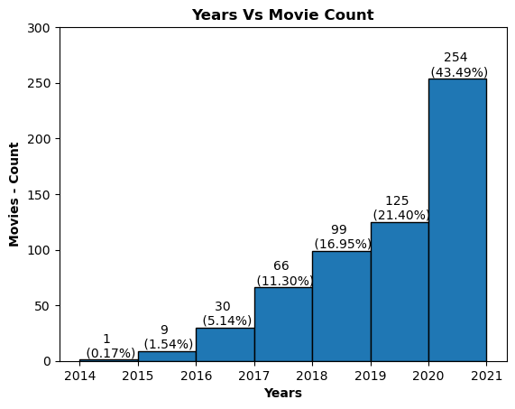
1. Released Time/Year
The dataset comprises 584 rows of data, encompassing an 8-years span from 2014 to 2021.
The number of movies increased to 5% year and reached a peak of 22% in 2020–2021.
This surge was attributed to the COVID-19 pandemic, prompting people to watch more movies while spending increased time at home.

Slide 5
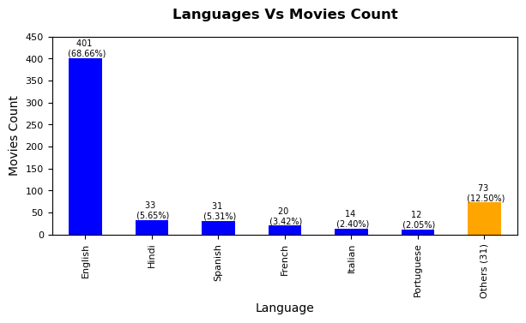
2.Languages
To better engage with audiences in different regions, there's a need to prioritize local languages.
For instance, offering more movies and series in languages like Hindi, Tamil, Telugu, and Malayalam in Indian territories.
There's a higher predominance of English-language movies in its catalogue.

Slide 6
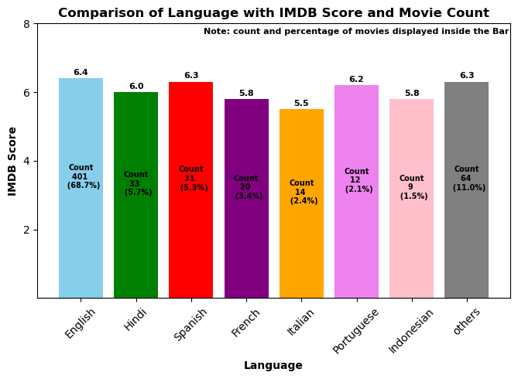
English films dominate both in total count and IMDb ratings, standing at a solid 6.4.
Despite a limited release of 30-35 movies, Hindi & Spanish maintains a commendable average IMDb score nearby 6.0.
Italian and Indonesian movies, reflect a comparatively lower interest among viewers.

Slide 7
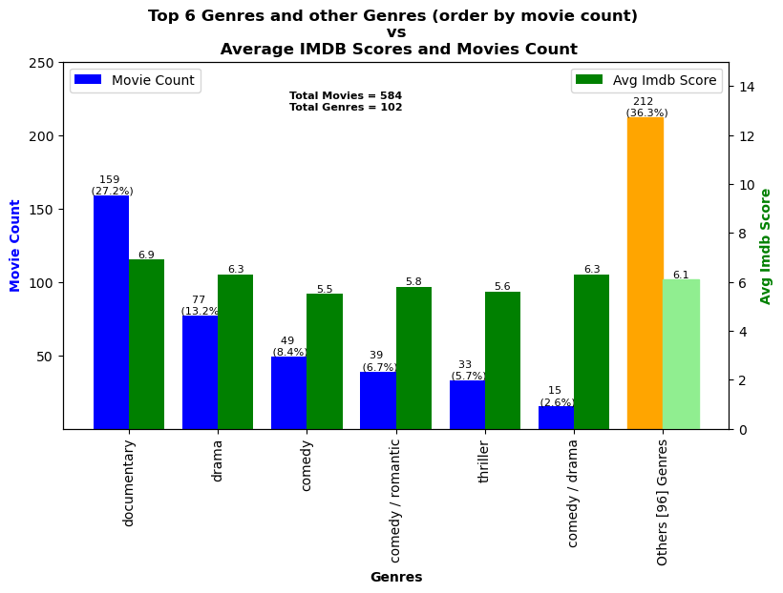
3. Genres
Documentary films make up 27% of the total, while Drama accounts for 13%.
Comedy and Romantic Comedy collectively represent 8.4% and 6.7%, respectively.
Thrillers make up 5.7% of the movies, and the Comedy/Drama genre combination comprises 2.6%.
Apart from these six genres, the remaining 36% of movies fall under a diverse range of 96 categories

Slide 8
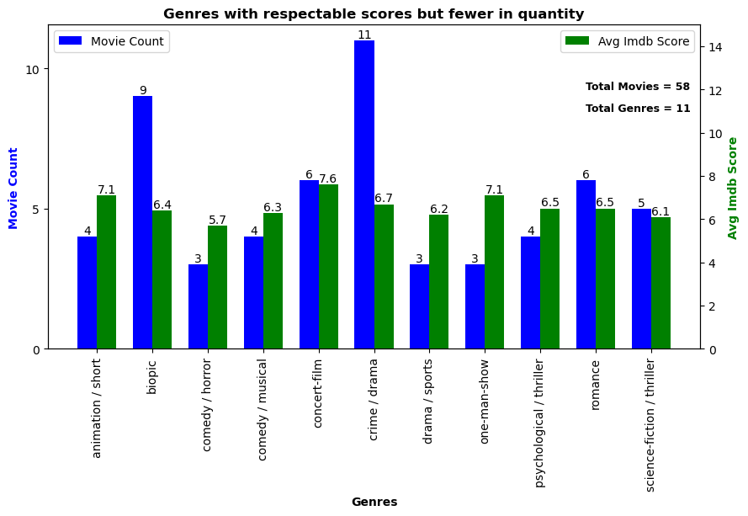
Few genres have garnered impressive scores.

Slide 9
Conclusion
Implementing the below tactics could help us grow our user base significantly.
1
2
3
4
Releasing more movies during holiday seasons or times of a pandemic, when people tend to stay at home more, typically boosts user engagement and can contribute to the growth of the business.
Increasing the number of movie releases in languages such as Hindi, Spanish, and French attracts a larger audience.
Expanding the releases in the Documentary Genre appeals to a broader viewership.
Additionally, The following genres, which have fewer films in their catalogue yet excellent reviews, demonstrate the audience's strong preferences. There will undoubtedly be more customers if these genres are released more frequently.
They are:
animation / short;biopic;comedy / horror;comedy / musical; concert-film;crime / drama
drama / sports;one-man-show;psychological / thriller
Romance;science-fiction / thriller

Slide 10
Thank You !

